Slide 1
Unit-VII
System Level Interaction with Python
1

Slide 2
Contents
Reading Data Interactively
Standard Streams
Environment Variables
Command Line Arguments
Exit Status
Running system commands in python
Obtaining the output of a system command
2

Slide 3
Sys Module
The sys module in Python provides various functions and variables that are used to manipulate different parts of the Python runtime environment.
It allows operating on the interpreter as it provides access to the variables and functions that interact strongly with the interpreter. Let’s consider the below example.
The python sys module contains methods and variables for modifying many elements of the Python Runtime Environment. It allows us to access parameters and functionalities specific to the system.
This module gives you access to some variables that the interpreter uses or maintains, as well as functions that interact with it. It is available at all times.
3

Slide 4

4

Slide 5
In the above example, sys.version is used which returns a string containing the version of Python Interpreter with some additional information.
This shows how the sys module interacts with the interpreter.
5

Slide 6
Input and Output using sys
The sys modules provide variables for better control over input or output. We can even redirect the input and output to other devices. This can be done using three variables –
stdin
stdout
stderr
6

Slide 7
stdin
stdin: It can be used to get input from the command line
directly. It used is for standard input.
It internally calls the input() method. It, also, automatically adds ‘\n’ after each sentence.
sys.stdin reads input from the keyboard, but it can also be used to read input from a file or from another program. This flexibility allows you to redirect input from different sources depending on your needs.
7

Slide 8
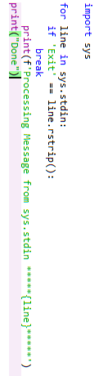
8

Slide 9
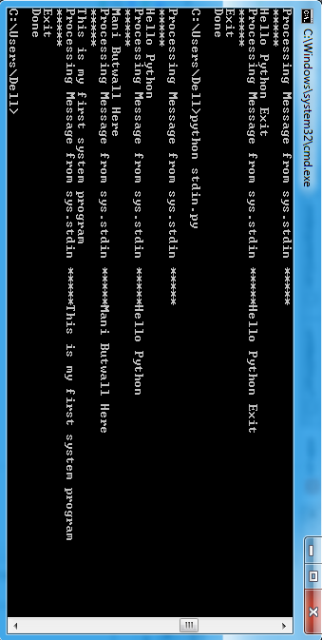
9

Slide 10
import sys
# Read input from the user
name = sys.stdin.readline()
# Print a greeting message
print("Hello, " + name)

Slide 11
stdout
stdout: A built-in file object that is analogous to theinterpreter’s standard output stream in Python.
stdout is used to display output directly to the screen console. Output can be of any form, it can be output from a print statement, an expression statement, and even a prompt direct for input.
By default, streams are in text mode. In fact, wherever a print function is called within the code, it is first written to sys.stdout and then finally on to the screen.
10

Slide 12
The stdout object provides a way to control where the output is directed. By default, it is set to the console. However, you can redirect the output to a file or another program if needed.

Slide 13

11

Slide 14
import sys
# Open a file in write mode
with open("output.txt", "w") as f:
# Redirect output to the file
sys.stdout = f
# Write output to the file
sys.stdout.write("Hello, World!\n")

Slide 15
stderr
.
In Python, the stderr object from the sys module refers to the standard error stream. It is used to display or log error messages or warnings from your Python program.
The stderr stream is specifically designed for error messages or warnings. By convention, error messages or any output related to exceptional conditions are typically directed to stderr instead of stdout. This separation helps users distinguish regular output from error messages

Slide 16
import sys
# Write an error message to the console
sys.stderr.write("An error occurred!\n")

Slide 17
Command Line Arguments
Command-line arguments are those which are passed during the calling of the program along with the calling statement. To achieve this using the sys module, the sys module provides a variable called sys.argv. It’s main purpose are:
It is a list of command-line arguments.
len(sys.argv) provides the number of command-line
arguments.
sys.argv[0] is the name of the current Python script.
Example: Consider a program for adding numbers and the
numbers are passed along with the calling statement.
12

Slide 18
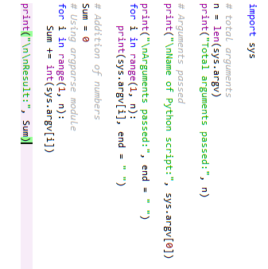
13

Slide 19
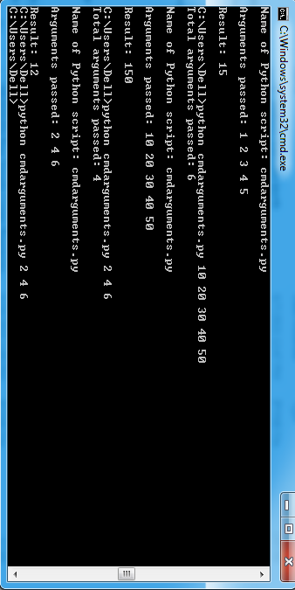
14

Slide 20
Exit
Exiting the Program
sys.exit([arg]) can be used to exit the program. The optional argument arg can be an integer giving the exit or another type of object. If it is an integer, zero is considered “successful termination”.
•
15

Slide 21
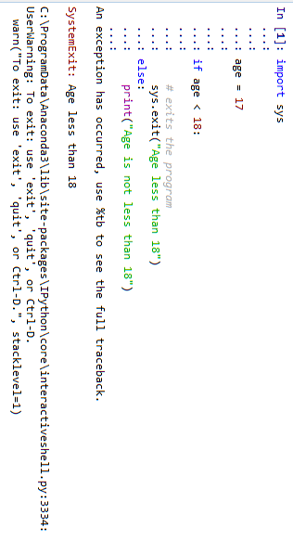
16

Slide 22
Working with Modules
sys.path is a built-in variable within the sys module that returns the list of directories that the interpreter will search for the required module.
When a module is imported within a Python file, the interpreter first searches for the specified module among its built-in modules. If not found it looks through the list of directories defined by sys.path.
Note: sys.path is an ordinary list and can be manipulated.
Example 1: Listing out all the paths
17

Slide 23
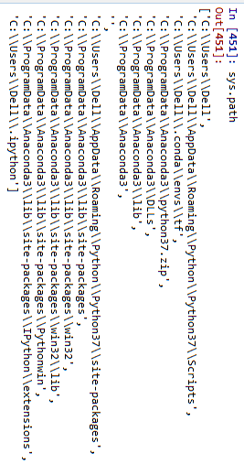
18

Slide 24
Reference Count
sys.getrefcount() method is used to get the reference count for any given object. This value is used by Python as when this value becomes 0, the memory for that particular value is deleted.
19

Slide 25
Function | Description
sys.setrecursionlimit() | sys.setrecursionlimit() method is used to set the maximum depth of the Python interpreter stack to the required limit. allows you to set the maximum recursion depth for recursive functions.
sys.getrecursionlimit() | sys.getrecursionlimit() method is used to find the current recursion limit of the interpreter or to find the maximum depth of the Python interpreter stack.
sys.settrace() | allows you to set a tracing function for tracking the execution of your program. It enables you to monitor and analyze the flow of code by executing a specified function for each line of code that is executed.
sys.setswitchinterval() | allows you to set the interval for thread switching. It determines how frequently the interpreter switches between different threads when executing multi-threaded programs.
sys.maxsize() | represents the maximum value that can be used as an index for sequences or arrays. It represents the largest positive integer that can be used as an index in Python.
sys.getdefaultencoding() | allows you to retrieve the default encoding used by the Python interpreter for string operations. It returns a string representing the default encoding.. | 20

Slide 26
import sys
# Define a tracing function
def trace_func(frame, event, arg):
print(f"Executing line {frame.f_lineno}")
# Return the tracing function for the next line
return trace_func
# Set the tracing function
sys.settrace(trace_func)
# Your code goes here
# Disable the tracing function
sys.settrace(None)

Slide 27
This function takes three parameters: frame, event, and arg. The frame parameter represents the current execution frame, event indicates the type of event being traced (e.g., line execution, function call), and arg provides additional information related to the event.

Slide 28
Function | Description
platform | Name of the platform on which Python is running, e.g. "linux2" for Linux and "win32" for Windows>>> sys.platform 'linux' >>>
version | Version number of the Python interpreter>>> sys.version '3.8.5 (default, Sep 4 2020, 07:30:14) \n[GCC 7.3.0]' >>>
version_info | Similar information than sys.version, but the output is a tuple containing the five components of the version number: major, minor, micro, release-level, and serial. The values of this tuple are integers except the value for the release level, which is one of the following: 'alpha', 'beta', 'candidate', or 'final'.>>> sys.version_info sys.version_info(major=3, minor=8, micro=5, releaselevel='final', serial=0) >>>
21

Slide 29

Function | Description
getsizeof | Return the size of object in bytes.>>> x = 5 >>> sys.getsizeof(x) 28 >>> s = "hello" >>> sys.getsizeof(s) 54
stdin stdout stderr | These attributes contain the original values of stdin, stderr and stdout at the start of the program. They can be useful to print to the actual standard stream no matter if the sys.std* object has been redirected. They can also be used to restore the actual files to known working file objects in case they have been overwritten with a broken object. But instead of using these values, the original stream should always be explicitly saved in a variable (as shown in our previous examples) before replacing it, and the original state should be restored by using the saved object.
22

Slide 30

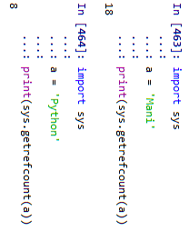
23

Slide 31


24

Slide 32

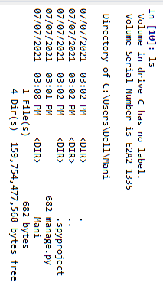

25

Slide 33
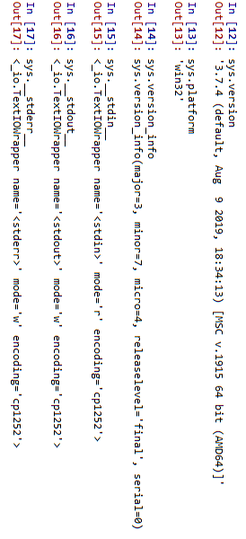
26

